Slide 1
4x Single Image Superresolution by Deep Convolutional Neural Network
By Md. Shamim Hussain (0417062229)

Slide 2
Objectives
In recent years, deep Convolutional Neural Networks (CNN) have shown superior performance in Single Image Super-Resolution (SISR). To this end, we propose to experiment with several deep learning approaches proposed for SISR such as:
Fully Convolutional Neural Network with per-pixel loss (such as Euclidian distance) [1]
Fully Convolutional Neural Network with perceptual loss [2]
Sub-pixel Convolutional Neural Network [3]
Results from different approaches will be compared in terms of perceived and quantitative measures.

Slide 3
Single Image Super-resolution (SISR)
Given a Low Resolution (LR) image, the High Resolution (HR) version of the image must be predicted.
SISR is inherently an ill-posed problem, i.e. there are multiple possible solutions to this problem which may be almost equally likely.
This is due to the lost / unavailable information in the LR image.

Slide 4
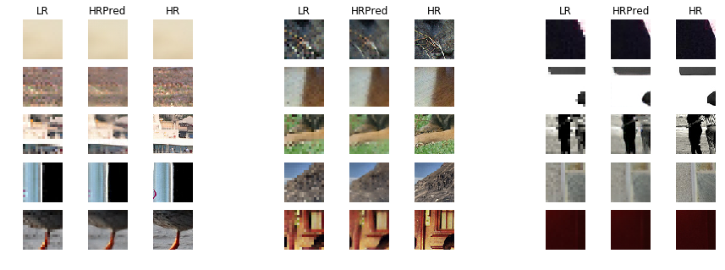
Example

Slide 5
Methodology

Slide 6
Network Architecture: Incremental Up-sampling

Slide 7
Dataset Description
The training and validation dataset comprised of 5200 images. ~3000 images were from ILSVRC 2014 validation set and ~2200 images were from MirFlickr.
The test set had 1600 images taken from ILSVRC 2012 validation set.
The datasets contain natural images along with illustrations, drawings etc.

Slide 8
Training Procedure
We separated all the files in the dataset into 75% training and 25% validation set.
We created 32x32 overlapped patches from the training set.
The low resolution patches (8x8) were created by 4x down-sampling by linear interpolation method.
The network was tasked with predicting the HR patch from the LR patch.
The fully convolutional nature of the network allows variable image sizes at test time.

Slide 9
Per-pixel Loss

Slide 10
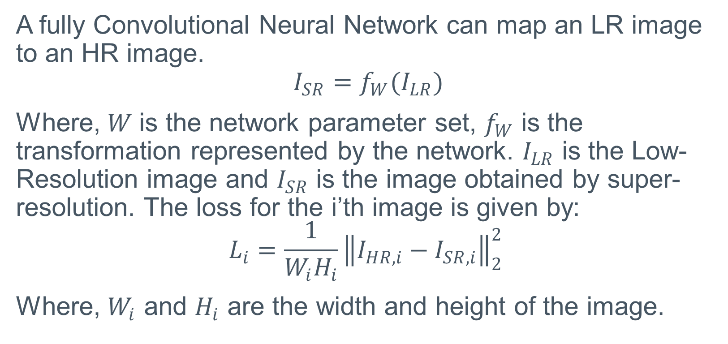
Per-pixel Loss
A fully Convolutional Neural Network can map an LR image to an HR image.
$$I_{SR}=f_{W}(I_{LR})$$
Where, $W$is the network parameter set, $f_{W}$ is the transformation represented by the network. $I_{LR}$ is the Low-Resolution image and $I_{SR}$ is the image obtained by super-resolution. The loss for the i’th image is given by:
$$L_{i}=\frac{1}{W_{i}H_{i}}{\left\|I_{HR,i}−I_{SR,i}\right\|}_{2}^{2}$$
Where, $W_{i}$ and $H_{i}$ are the width and height of the image.

Slide 11
Results
PSNR and SSIM were measured by taking average for the images in the test set
Method | PSNR (dB) | SSIM
Bi-cubic | 23.70 | 0.6577
Super-resolution | 24.11 | 0.6710

Slide 12

Demonstration

Slide 13

Demonstration

Slide 14
Perceptual Loss

Slide 15
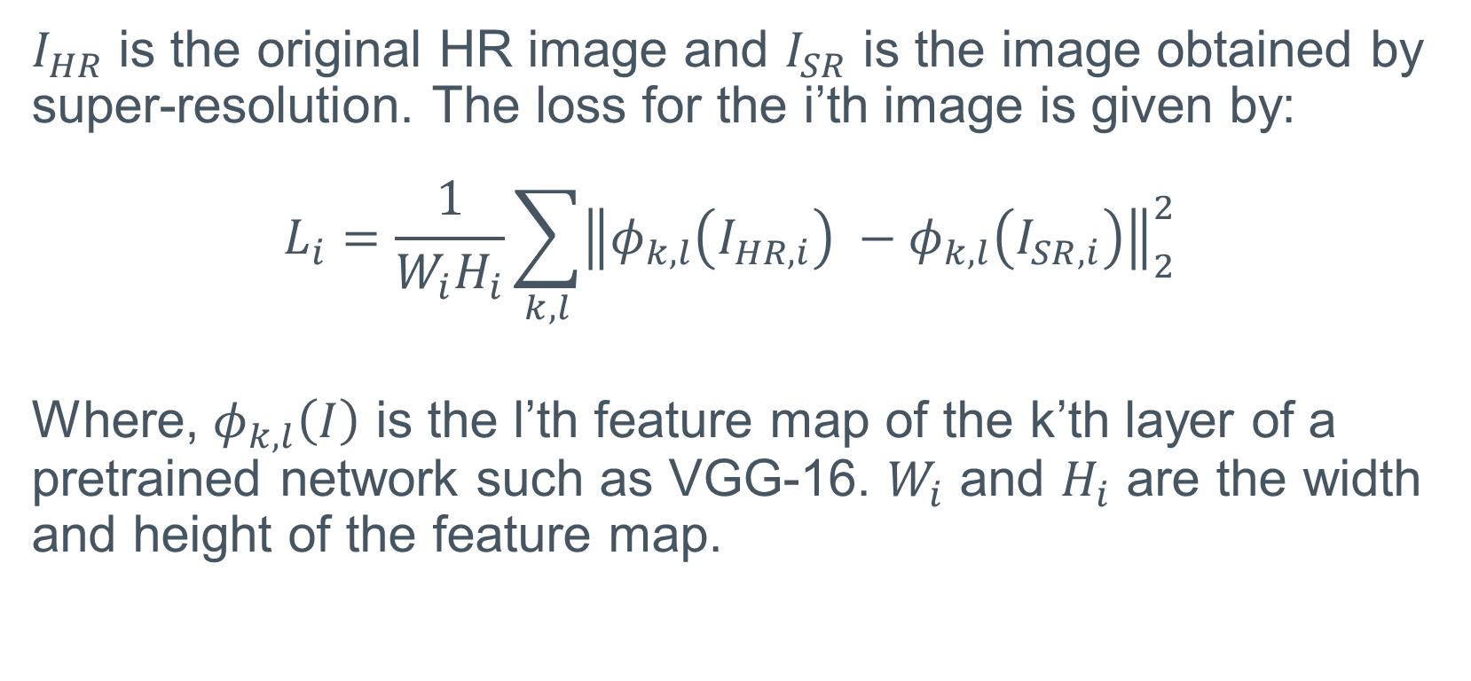
Perceptual Loss
$I_{HR}$ is the original HR image and $I_{SR}$ is the image obtained by super-resolution. The loss for the i’th image is given by:
$$L_{i}=\frac{1}{W_{i}H_{i}}\sum_{k,l}{{\left\|φ_{k,l}\left(I_{HR,i}\right) −φ_{k,l}\left(I_{SR,i}\right)\right\|}_{2}^{2}}$$
Where, $φ_{k,l}\left(I\right)$ is the l’th feature map of the k’th layer of a pretrained network such as VGG-16. $W_{i}$ and $H_{i}$ are the width and height of the feature map.

Slide 16
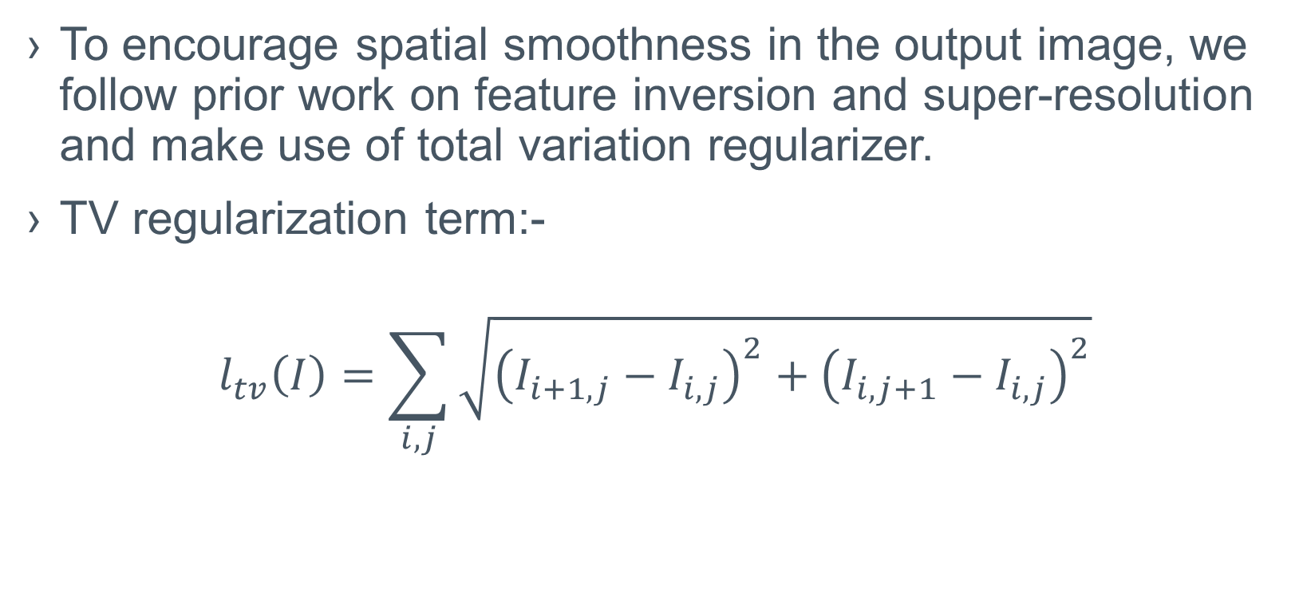
Total Variation Regularization
To encourage spatial smoothness in the output image, we follow prior work on feature inversion and super-resolution and make use of total variation regularizer.
TV regularization term:-
$$l_{tv}\left(I\right)=\sum_{i,j}{\sqrt{{\left(I_{i+1,j}−I_{i,j}\right)}^{2}+{\left(I_{i,j+1}−I_{i,j}\right)}^{2}}}$$

Slide 17
Results
For perceptual loss, objective measures are lower, because it does not directly minimize pixelwise MSE loss.
Method | PSNR (dB) | SSIM
Bi-cubic | 23.70 | 0.6577
Super-resolution (Pixel-wise loss) | 24.11 | 0.6710
Super-resolution (Perceptual loss) | 22.50 | 0.6053

Slide 18
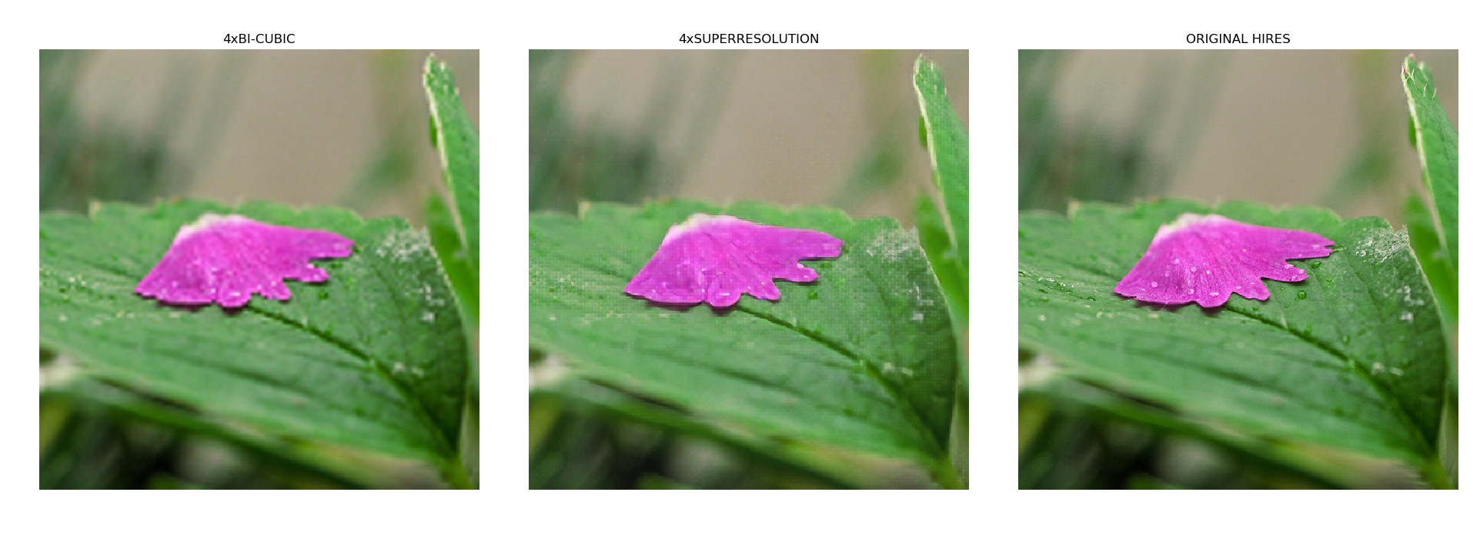
Demonstration

Slide 19
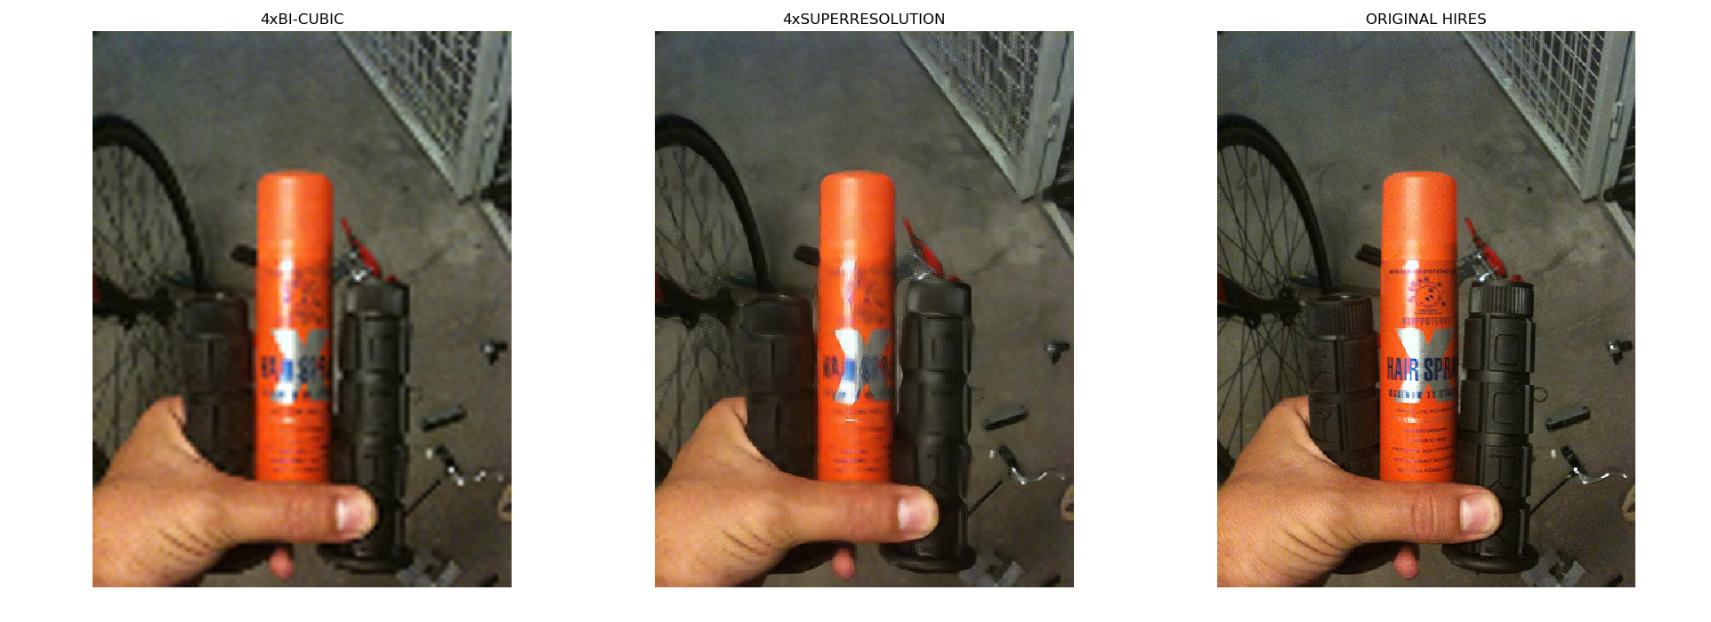
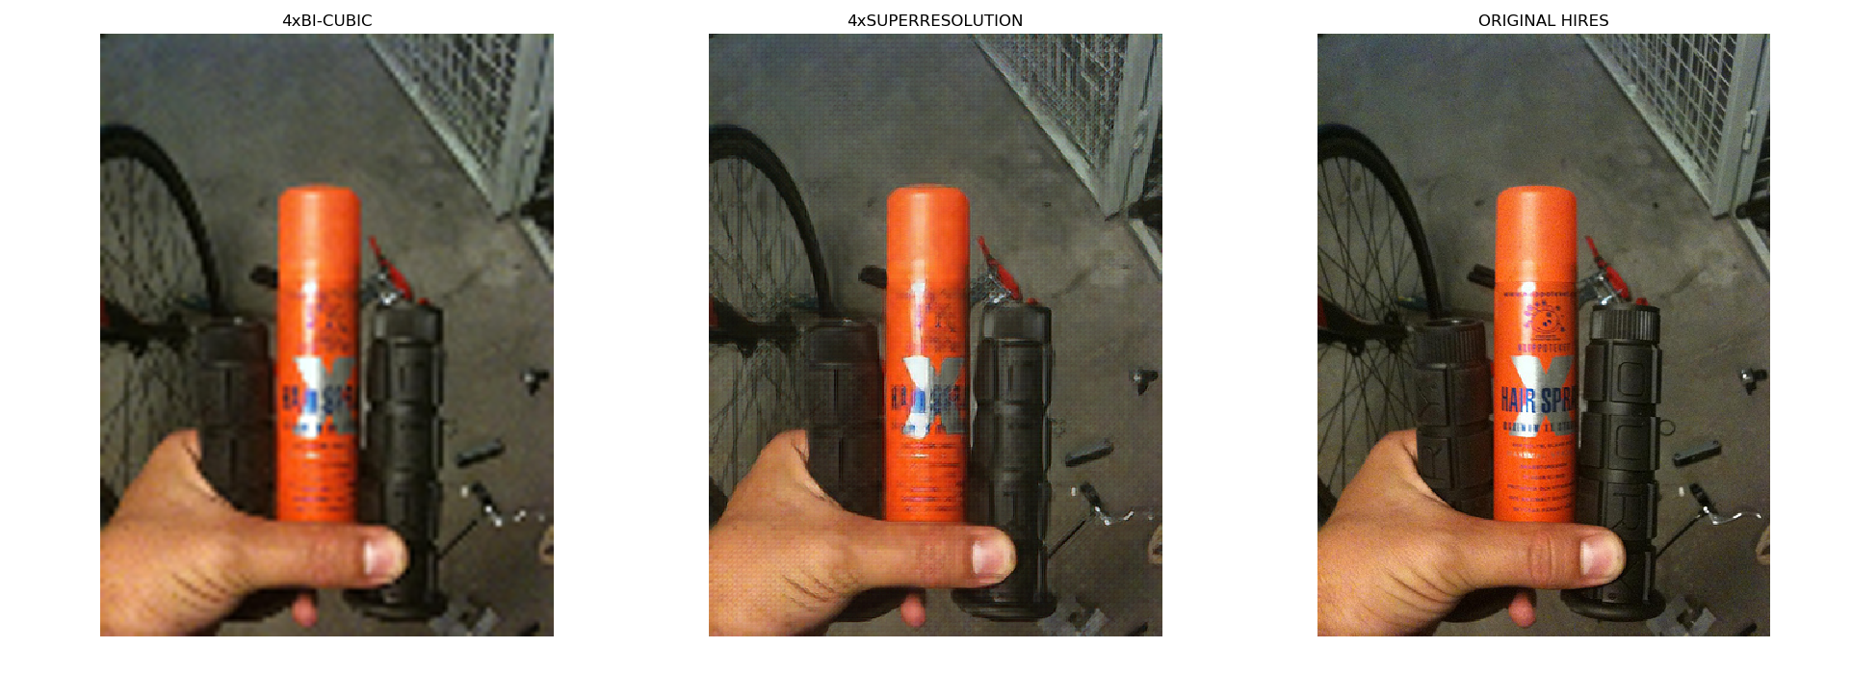
Comparision with Pixel-wise Loss
Pixel-wise
Perceptual

Slide 20
Sub-pixel CNN

Slide 21
Sub-pixel CNN
This architecture, first apply a l layer convolutional neural network is applied directly to the LR image, and then apply a sub-pixel convolution layer that upscales the LR feature maps to produce SR image.
Convlution is performed only on LR image. So much faster and consumes less resource.

Slide 22
Network Architecture

Slide 23
Results
Achieves similar results to incremental upsampling while being fast and lightweight.
Method | PSNR (dB) | SSIM
Bi-cubic | 23.70 | 0.6577
Super-resolution (Incremental) | 24.11 | 0.6710
Super-resolution (Sub-pixel) | 24.10 | 0.6573

Slide 24
Applications

Slide 25


Applications
100% (Original)
200% (4x SR – Downscaled)
400% (4x SR)

Slide 26

Comparison with a Commercial Software (ACDSee)
ACDSee
ACDSee
SR
SR

Slide 27


Practical Application

Slide 28

Practical Application

Slide 29
References
[1] C. Dong, C. C. Loy, K. He, and X. Tang, "Image super-resolution using deep convolutional networks," IEEE transactions on pattern analysis and machine intelligence, vol. 38, pp. 295-307, 2016.
[2] J. Johnson, A. Alahi, and L. Fei-Fei, "Perceptual losses for real-time style transfer and super-resolution," in European Conference on Computer Vision, 2016, pp. 694-711.
[3] W. Shi, J. Caballero, F. Huszár, J. Totz, A. P. Aitken, R. Bishop, et al., "Real-time single image and video super-resolution using an efficient sub-pixel convolutional neural network," in Proceedings of the IEEE Conference on Computer Vision and Pattern Recognition, 2016, pp. 1874-1883.
[4] C. Ledig, L. Theis, F. Huszár, J. Caballero, A. Cunningham, A. Acosta, et al., "Photo-Realistic Single Image Super-Resolution Using a Generative Adversarial Network," in CVPR, 2017, p. 4.

Slide 30


